Slide 1
Forecasting Crude Oil and Gasoline Prices
By Mason Zepnick, Kennan Walter, Arun Srivatsan Swaminathan, Prageeshwar Chandran

Slide 2
What is the data?
Time-series of crude oil and gasoline prices from 1986 - 2016
Variables
Year
Price of crude oil(Cushing, OK WTI Spot Price FOB (Dollars per Barrel))
Europe Brent Spot Price FOB (Dollars per Barrel)
Price of Gasoline (New York Harbor Conventional Gasoline Regular Spot Price FOB (Dollars per Gallon))
U.S. Gulf Coast Conventional Gasoline Regular Spot Price FOB (Dollars per Gallon)

Slide 3
The Goal
Forecast future crude oil and gasoline prices based on historical data

Slide 4
Questions to Answer
1. Are there any seasonal patterns or trends in the data?
2. Can we accurately predict future prices of crude oil and gasoline based on historical data?
What is the level of uncertainty in our predictions?
3. How do political events, such as wars or sanctions, affect crude oil and gasoline prices? Can
we quantify the impact of these events on the price series?
4. Can we identify any outliers or anomalies in the data, and if so, what caused them?

Slide 5
Potential
Approaches
ARIMA models
Exponential Smoothing
Regression Analysis
Neural Networks or Decision Trees
Improve the accuracy of our forecast
Data Analysis
Identify trends, patterns, or outliers
Statistical Tests
Evaluate significance of any relationships or correlations between variables

Slide 6
Final Approaches
Trend Analysis
Decade-wise Analysis
Distribution Analysis
ACF and PACF
ARIMA Modeling
Decomposition of additive time-series
Exponential smoothing
Forecasting

Slide 7
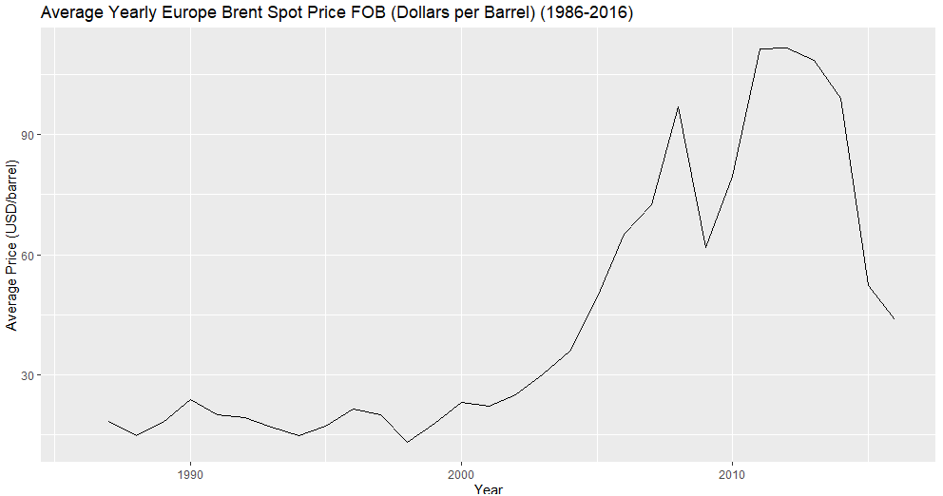
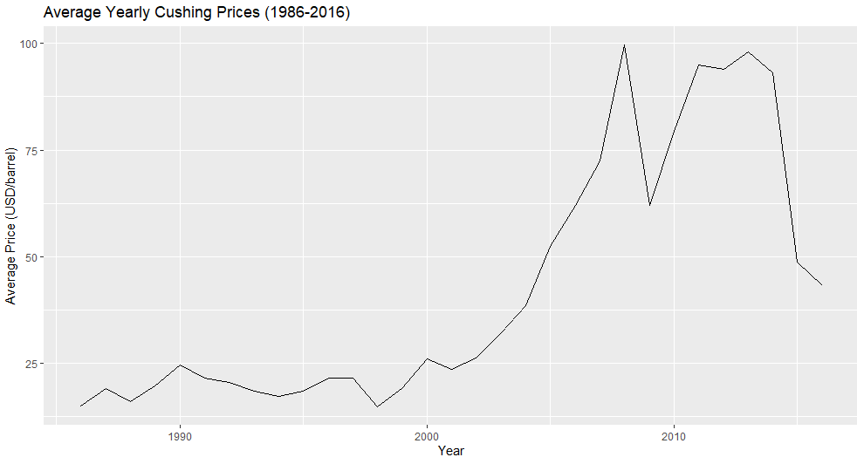
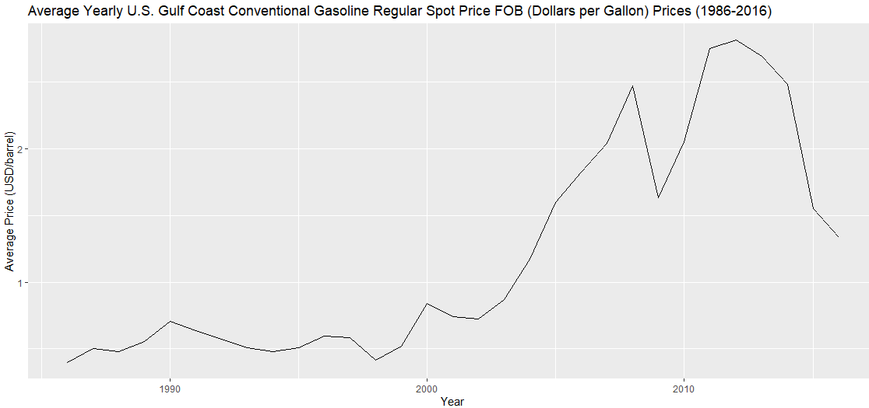
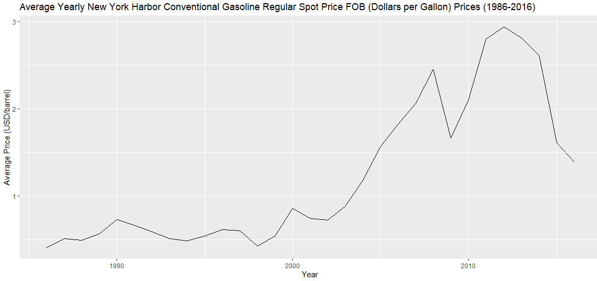
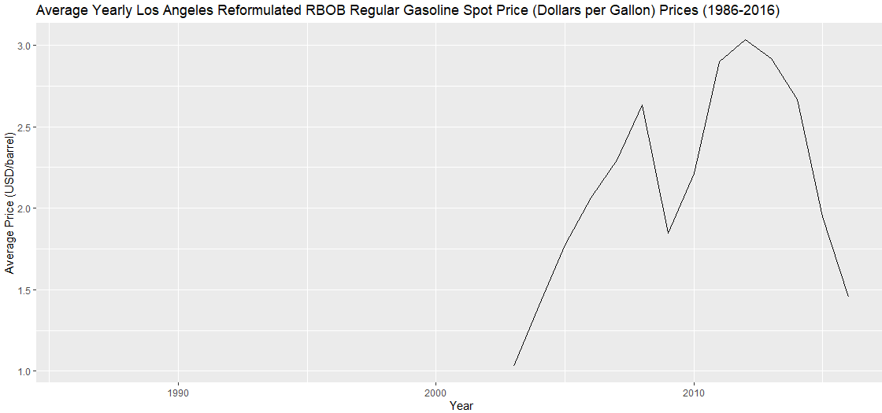
Results - Trend Analysis
Notes:
We use the "ggplot" function in R to create line plots for each type of crude oil and gasoline, with the years on the x-axis and the average prices on the y-axis. The line plots show the trends in crude oil and gasoline prices over the years, providing insights into price movements and patterns.

Slide 8
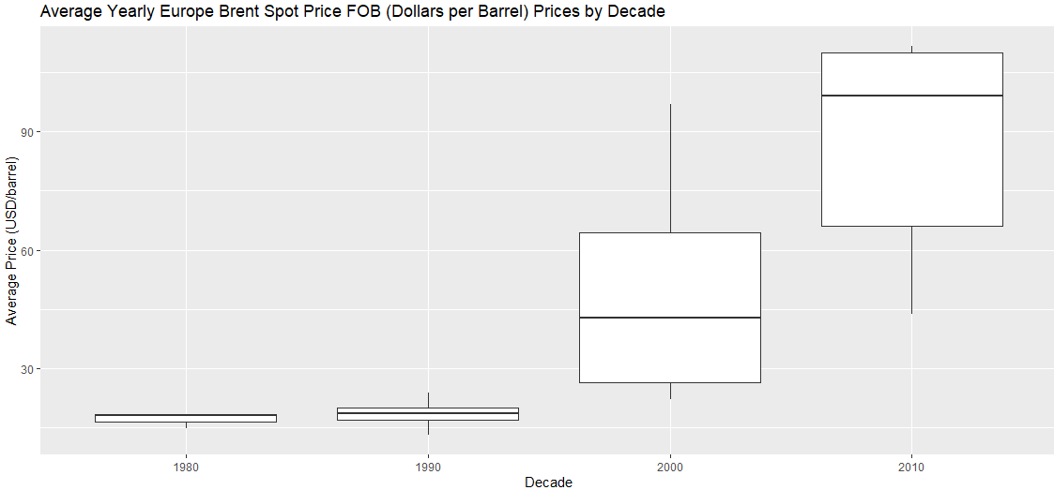
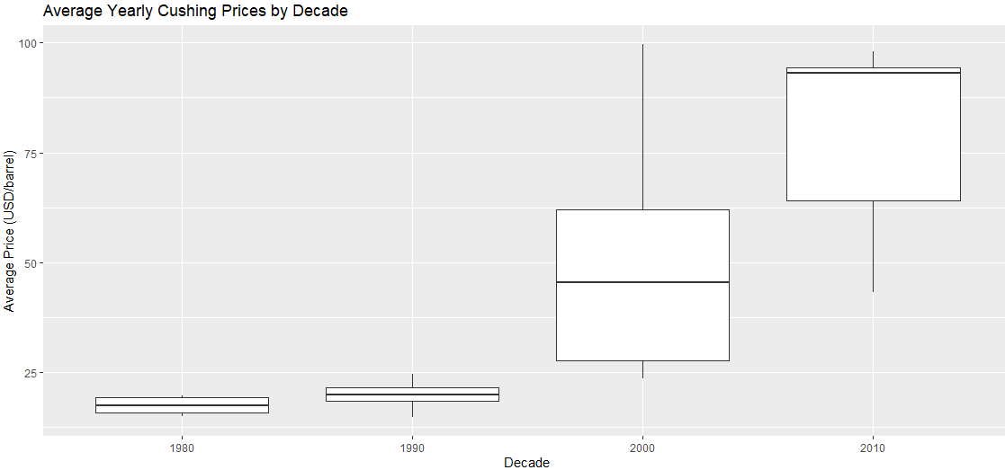
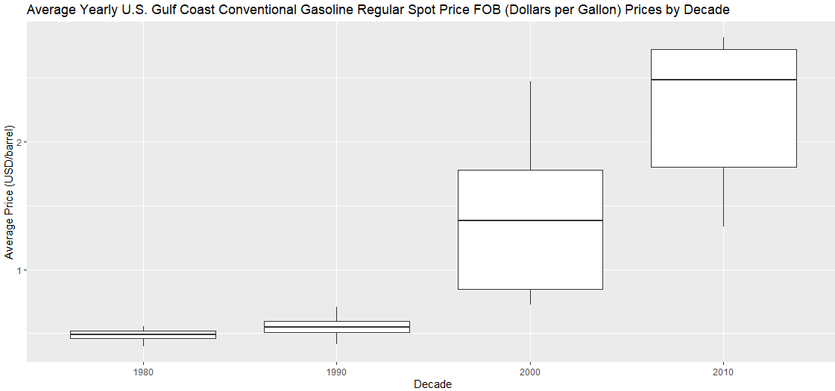
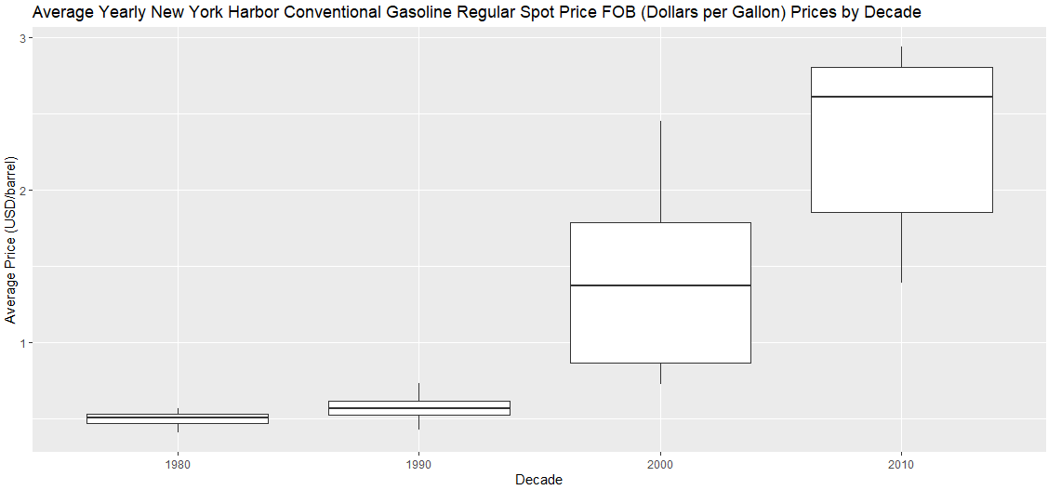
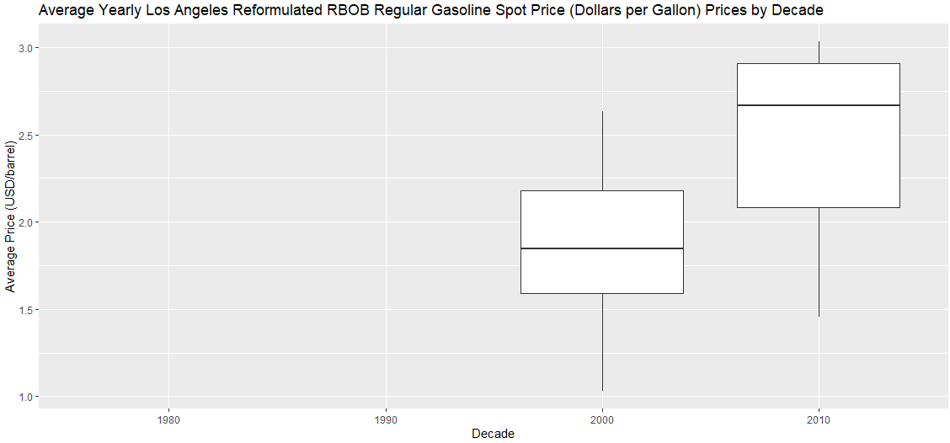
Results - Decade-Wise Analysis
Notes:
We use box plots to compare the average prices of crude oil and gasoline for each decade. The box plots provide information on the median, quartiles, and outliers of the data, allowing us to identify any significant differences in prices between decades.

Slide 9
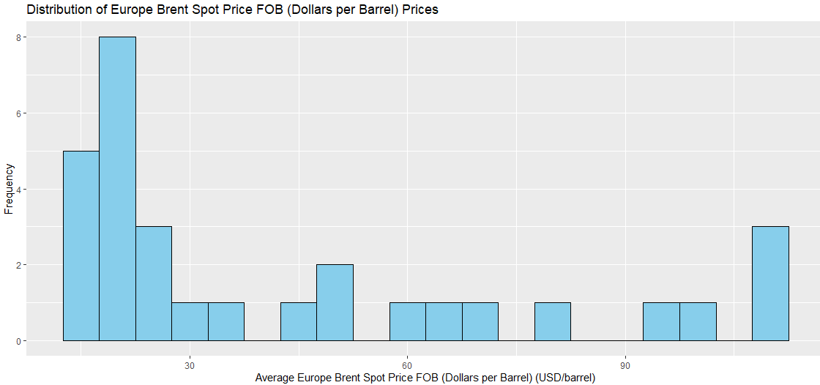
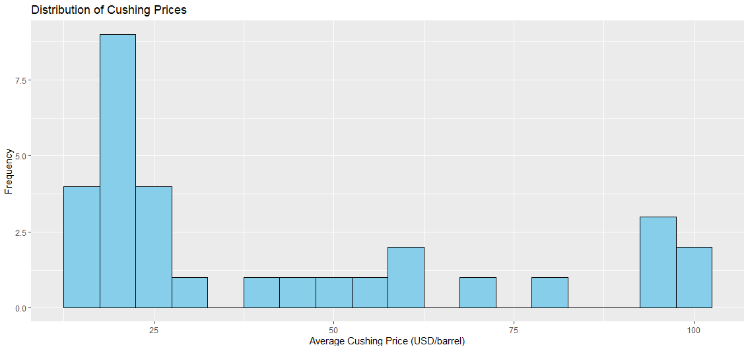
Results - Distribution Analysis
Notes:
We also analyze the distribution of crude oil and gasoline prices using histograms. We create histograms for each type of crude oil and gasoline, showing the frequency of prices within certain price ranges. The histograms provide insights into the distribution of prices and can help identify any skewness or asymmetry in the data.

Slide 10
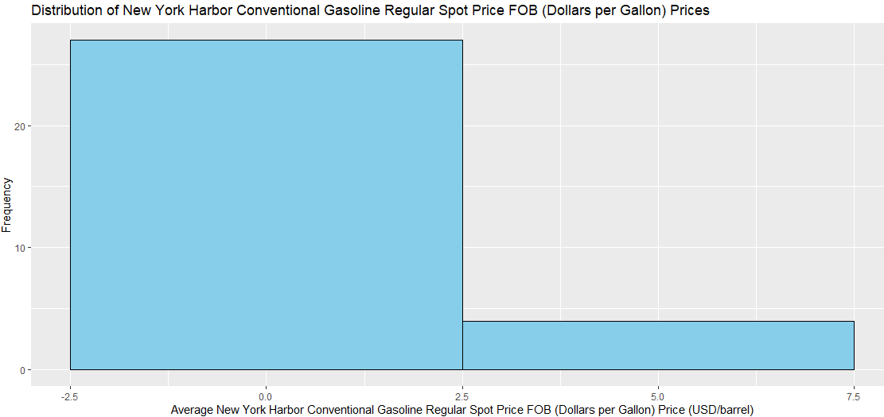
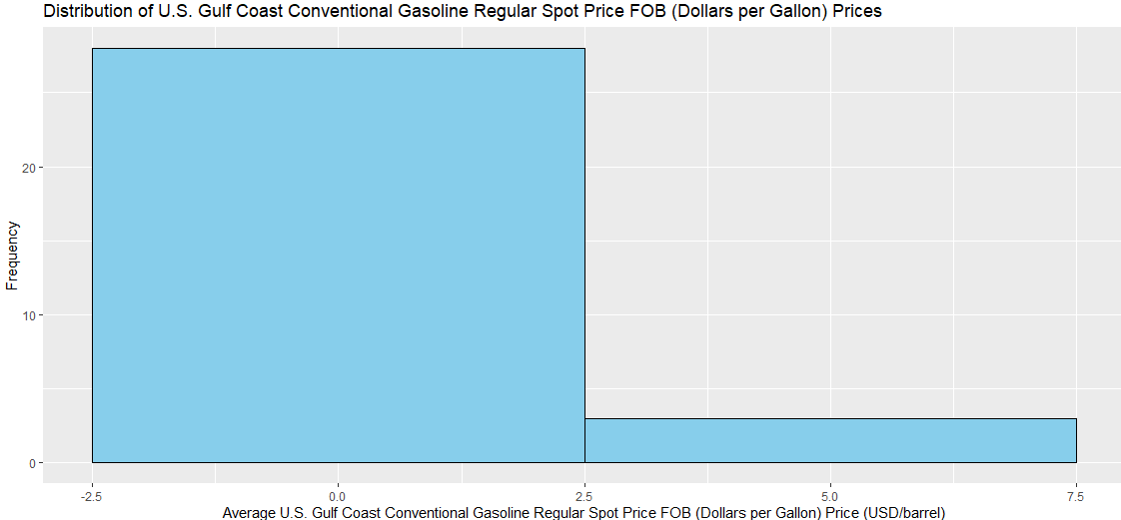
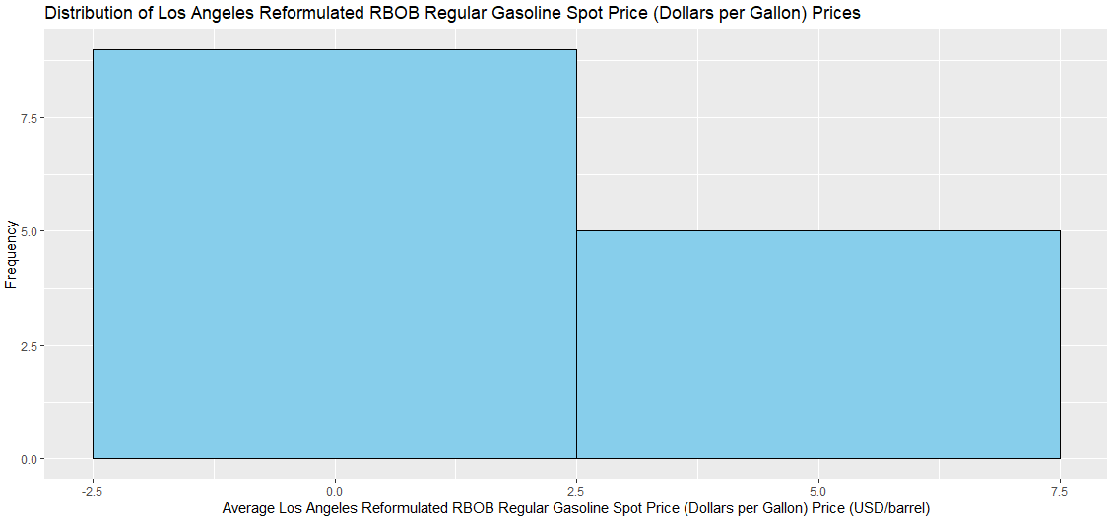
Results - Distribution Analysis

Slide 11
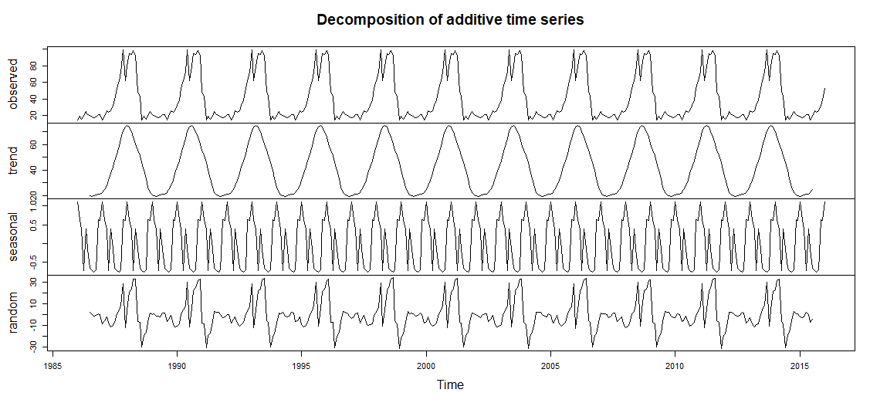
Results - Decomposition of Additive Time-Series

Slide 12
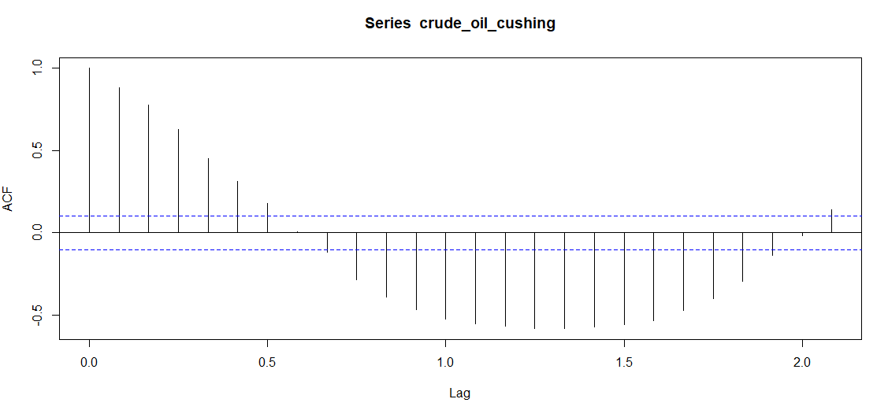
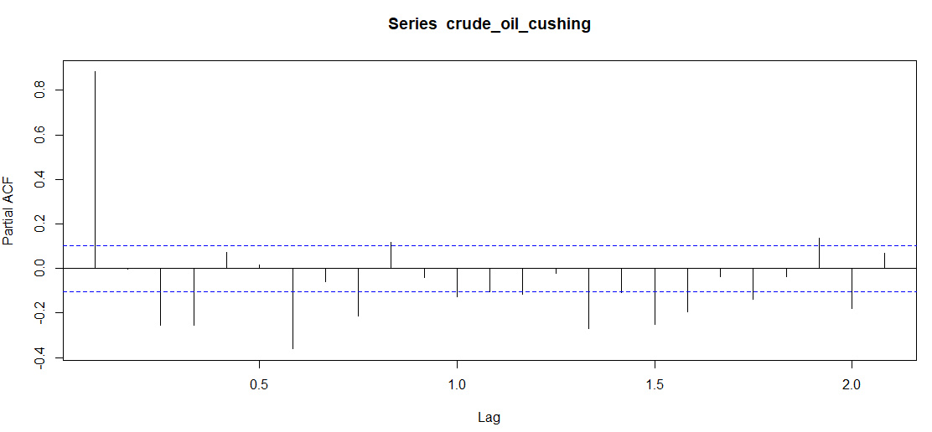
Results - ACF and PACF
Notes:
ACF (Autocorrelation Function) and PACF (Partial Autocorrelation Function) are important tools used in time series analysis to identify and interpret the correlation patterns within time series data. ACF identifies auto-correlation by measuring the similarity between current and lagged values, while PACF accounts for the influence of intermediate lags to determine the direct influence of each lag on the current value.

Slide 13
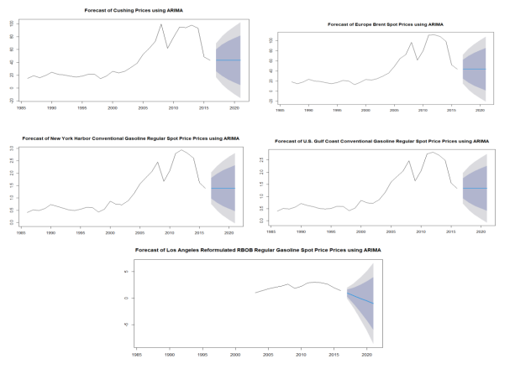
Results - ARIMA Modeling
Notes:
The ARIMA model is a popular time series forecasting method that can capture patterns and trends in the data. We use the "auto.arima" function in the "forecast" library to automatically select the best ARIMA model based on the data. We then fit the selected ARIMA model to the data and generate forecasts for the next year.

Slide 14
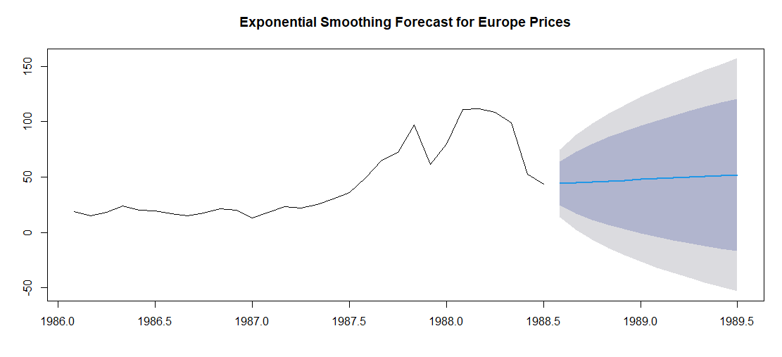
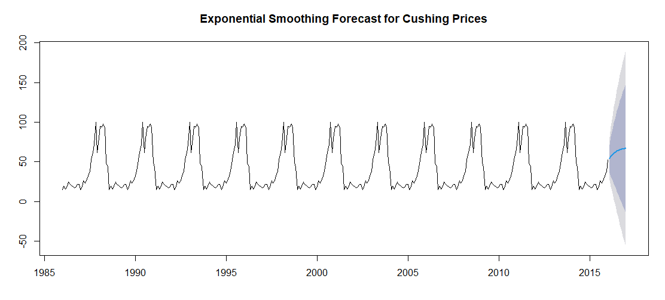
Results - Exponential smoothing

Slide 15
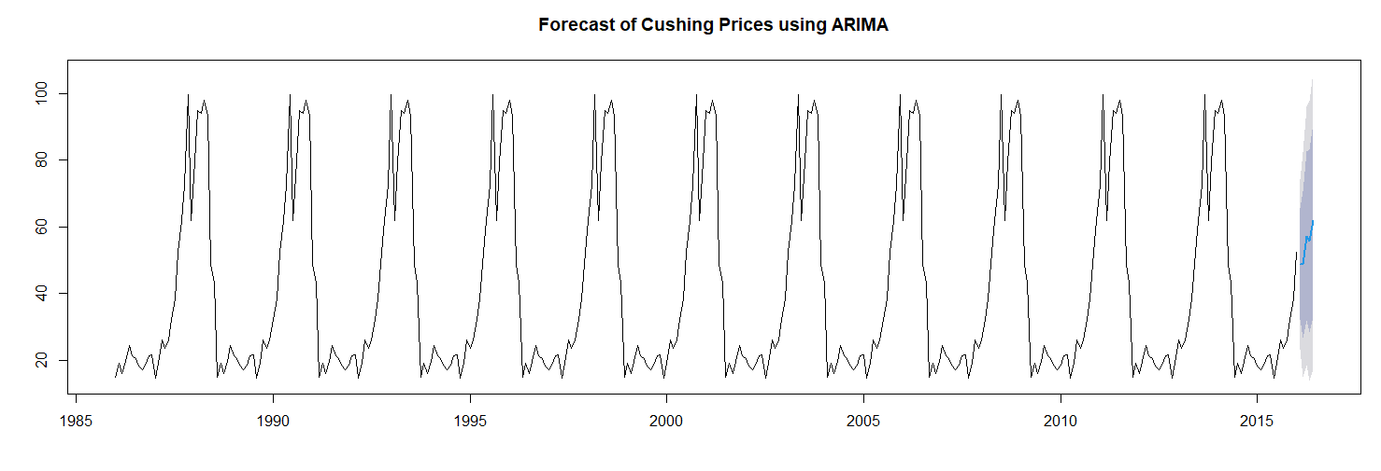
Results - Forecasting

Slide 16
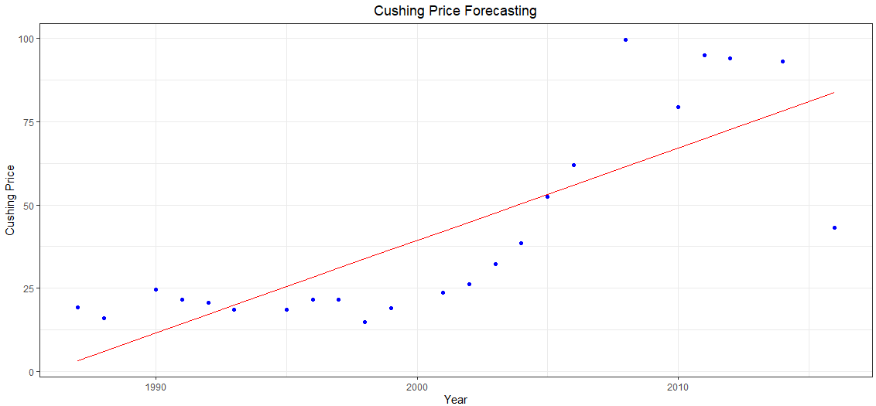
Results - Forecasting

Slide 17
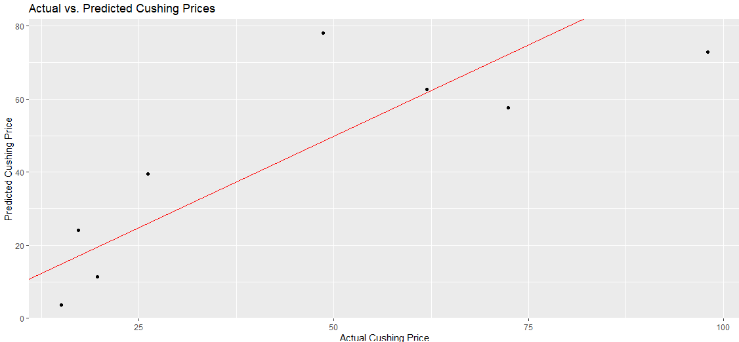
Results - Actual vs. Predicted

Slide 18
Conclusion
Analysis
Provides insights into trends, decade-wise changes, and distribution of crude oil and gasoline prices for different types
R-Studio
Understanding historical movements and patterns in pricing, while ARIMA modeling allows us to forecast the future prices
Findings
Useful for decision-making within industries and policy-making at a macroeconomic level

Slide 19
Thank you!
Any questions?

